Slide 1

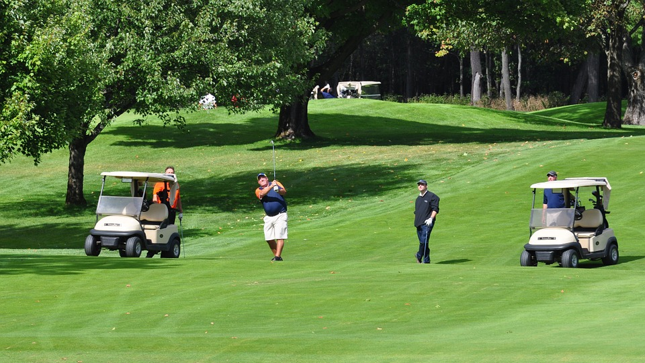
MVCC Ray Storey Golf day
Prizes for
Best Team
Closest the pin
Longest drive
Naga Award
Lunch Menu
Chicken Parma & Chips
Fish & Chips
Roast of the day
Vegan & Vegetarian by request
When: Sunday the 6th of June 2021
Where: Bacchus Marsh Golf Club Links Road Darley
Time: Arrive 7.30am for 8.00am hit off
Cost: $70.00 includes Golf, Lunch & first drink free. Golf carts extra and must be booked
Payment via MVCC website
Contact Danny Terzini by text 0407 341 477 or Ian Denny on 0438 926 594 ian.denny@gandvaustralia.com.au

